Slide 1
Vermont Flexible Load Management
Residential Technical Potential in 2030
May 13, 2024

Slide 2
Top-Line Results and Methods

Slide 3
Top-line Results – Technical Potential
Based on two major sources of information:
  EEU Program Achievable Potential of Key End-Uses
    HVAC (HPs and AC)
    Water Heating
  Forecasts of Vermont Light-Duty EVs
A variety of sources and assumptions to derive performance estimates
Residential FLM Technical Potential (MW)
Source | Summer High | Summer Low | Winter High | Winter Low
HVAC | 67.1 | 6.2 | 43.9 | 4.4
Water Heating | 7.4 | 0.8 | 7.4 | 0.8
EVs | 87.2 | 24.6 | 87.2 | 24.6
Total | 161.7 | 31.6 | 138.5 | 29.8

Slide 4
Challenges to FLM Potential
A need for clarity on the purpose of FLM:
  Monthly or annual peak load
  Targeted T&D system capacity management
  Integration of greater volumes of nondispatchable renewable energy
Loadshapes that define the purpose:
  Coincident system peak
  Substation-specific load characteristics and risk points
  8760 end-use loads
Program designs and use cases
  Inform adoption levels (DR generally caps ~30%)
  Passive or active load management
Our technical potential estimates attempt to capture a range

Slide 5
End-Use REsults
Methods and Outcomes

Slide 6
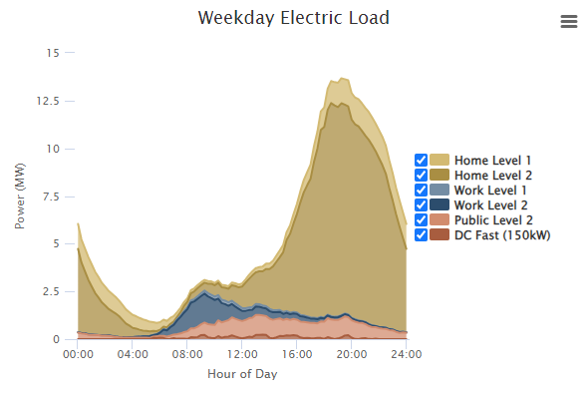
Electric Vehicles
Based on VTRANS/VELCO NEVI Forecasts (2023)
  Used middle case for light duty EVs
  Savings ranges based on Vermont TRM and National Grid evaluation
  71,624 EVs in middle case, 60% with at-home L2 chargers
  0.49 to 1.74 kW per vehicle
Example EV Loadshape
-10,000 EVs
-80% BEV
-80% L2 home charger
For illustration only
does not represent GDS FLM assumptions due to simulation parameter limitations
Residential EV L2 Charging FLM Technical Potential (MW)
High Savings | Low Savings
87.2 | 24.6
Source: EVI-Pro Lite, Burlington VT

Slide 7
Water Heating
Utilized counts of EEU Achievable Potential
  Does not capture prior installations, serves as a proxy
  5,772 HPWH through 2030
  10,297 smart tank controls (STC, assumes ER) through 2030
Savings based on MA study of HPWH and ER DHW
  Same data as used to inform VT TRM FLM savings
  Uses hourly max/min performance per season to derive the range
Residential DHW FLM Technical Potential in 2030 (MW)
Technology | Summer High | Summer Low | Winter High | Winter Low
HPWH (0.051 – 0.24 kW per unit) | 1.385 | 0.294 | 1.385 | 0.294
STC (0.052 – 0.58 kW per unit) | 5.973 | 0.535 | 5.973 | 0.535
Total | 7.358 | 0.830 | 7.358 | 0.830

Slide 8
HVAC – CCHps and RACs
A bit more complex than EVs or DHW
Two measure types:
  CCHPs (3 types, SF MF considerations)
  Room Air Conditioners (RAC, Efficiency Vermont-only measure)
Utilized counts of EEU Achievable Potential
  Does not capture prior installations, serves as a proxy
  29,133 RACs through 2030
  89,681 CCHPs through 2030 (multiple types)
Utilized Vermont TRM EFLH and Efficiency Vermont assumptions
  Peak load derived from heating and cooling penalties
  Single split HPs have shared MF & SF load assumptions
  Multisplit only to SF
  ASHPs have different SF and MF load assumptions

Slide 9
HVAC – More Assumptions and Results
Season peak savings depend on when you are trying to flex load
  Summer savings range:
    High: Assumes 50% of max cooling load could be managed
    Low: Assumes 5% of max cooling load (reflects off-peak conditions for FLM)
  Winter savings range:
    High: Assumes 20% of max heating load can be managed (per GMP IRP)
    Low: Assumes 2% of max heating load (off-peak, different winter conditions)
There is uncertainty on how dual fuel systems can operate to support FLM
Technology | Summer High | Summer Low | Winter High | Winter Low
RAC | 7.341 | 0.073 | 0.0 | 0.0
CCHP | 59.752 | 6.174 | 43.864 | 4.386
Total | 67.094 | 6.248 | 43.864 | 4.386

Slide 10
Conclusions and Discussion

Slide 11
Conclusions and Discussion
EEUS and EVs offer substantial residential FLM potential
Our estimate of technical potential is:
  Based on ranges of possible use cases for FLM
  Does not reflect programs or program adoptions
    Winter heating may - due to unknown factors from GMP IRP
    Program design will influence the nature of load shift/shimmy/shed
Recommendations
  Need to identify the use-case and value propositions for FLM
  Program designs reflecting the use-case will inform specific opportunity
  Develop achievable potential through program designs.
  30 percent is a reasonable target, though perhaps not by 2030
    Pacing likely to vary by program design and technology

Slide 12
Thank you!

