Slide 1


2026 Long-Term Forecast
Feb 18th, 2025
Itron, Inc: Mike Russo, Eric Fox, Brien Rissman

Slide 2

Agenda
Forecast Status
Baseline Forecast
Heat Pump, Solar, and EV Forecast
System Forecast
Forecast Scenarios

Slide 3
Workplan and Schedule

Slide 4
Status – What has been completed
Baseline energy and peak forecast the at system and zonal level
Baseline forecast includes the impact of economics, efficiency, and changes to historical data
Updated electric vehicle, heat pump, and solar forecasts based on input from prior subcommittee meeting completed
Multiple EV hourly profiles to account for TOU and non-TOU rates
Small and large solar generation profiles
State level forecast of technologies are allocated to zones based on income and/or historical adoption trends
Adjusted energy and peak forecast at system and zonal level
The baseline forecast is adjusted for the impact of solar, electric vehicles, and heat-pumps.
Comparison to the prior long-term load forecast

Slide 5
Schedule: Feb-April 2026
Construct forecast scenarios
Extreme weather conditions
Higher and lower technology adoption paths
Alternative EV charging profiles
Alternative battery storage and load control strategies
Presentation – Scenario results
Complete project report

Slide 6
Outstanding Items & Needs
Battery storage
Data on hourly charging and discharging patterns
Data on Installed capacity, ideally by zone
What percentage storage is controlled by DUs
Hourly heat pump shape data
Currently using a genetic heating profile not specific to heat pumps

Slide 7
The Baseline Forecast

Slide 8
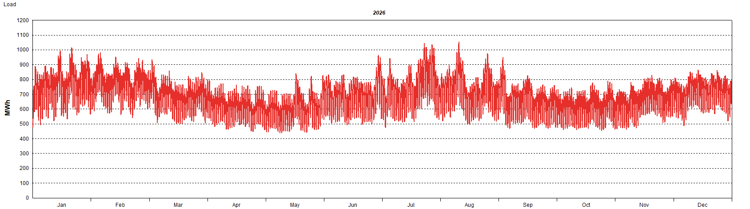
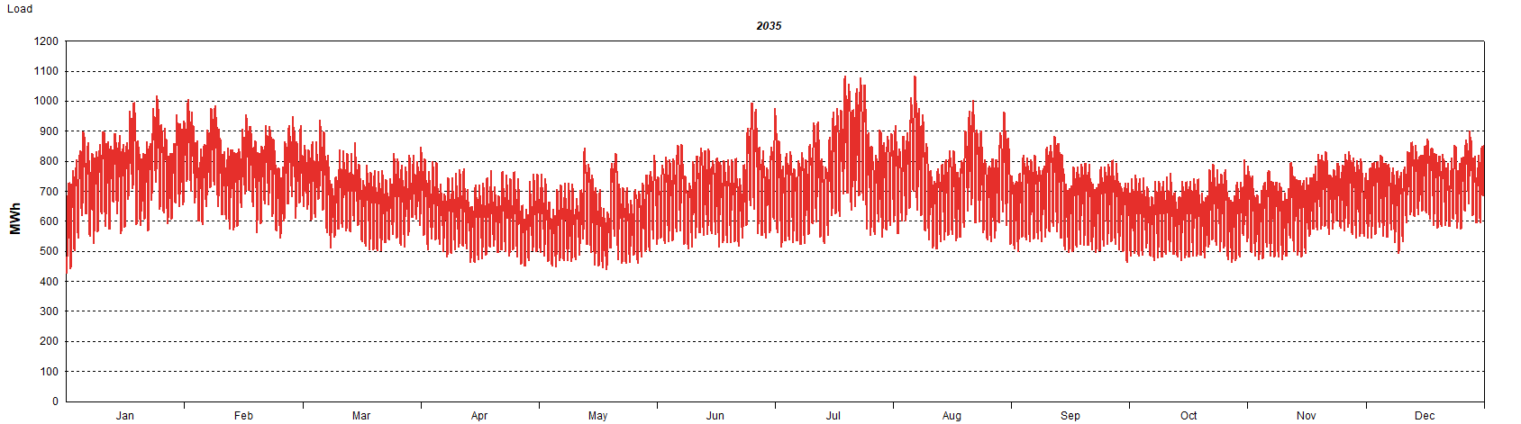
Baseline Gross Load Forecast 2026 and 2035
Measure of Vermont customer energy and demand requirements excluding the impact of future “new” technologies
Driven by:
Household and economic growth
End-use efficiency trends
Increasing temperatures
Summer Peaking, Afternoon (Excludes Solar Impact)

Slide 9
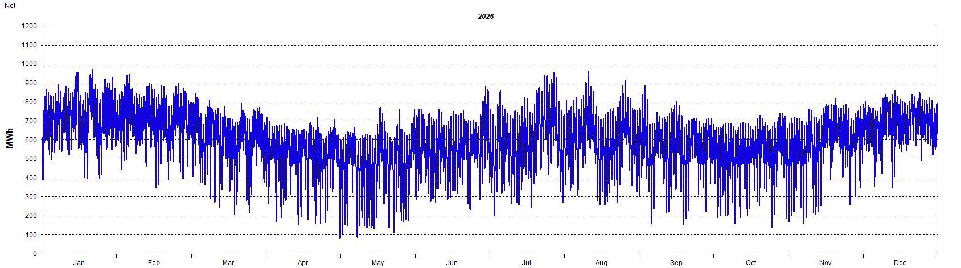

Baseline Net Load Forecast
Adjusted for existing solar generation
Baseline peak demand growth averages 0.23% over the next ten years.
With Solar, System Peak Shifts to the Evenings

Slide 10
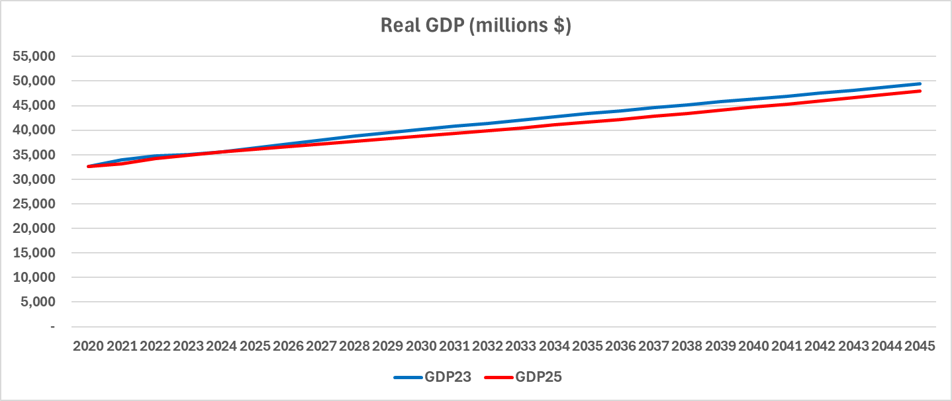
State Economic Outlook
Forecast based on Wood & Poole state economic outlook
County-level forecast for zones
Slow and steady population and economic growth
1.42% long-term gross state product growth
In comparison, U.S. GDP growth over the next five years is1.8% to 2.2%
W&P near-term GDP growth less than Moodys, but population, households, and employment growth is higher

Slide 11
Planning Zone Economics
County economic activity allocated to zones based on county population within each planning zone.
Moderate differences in household and economic growth across counties
Contributes to more variation in demand growth across zones

Slide 12
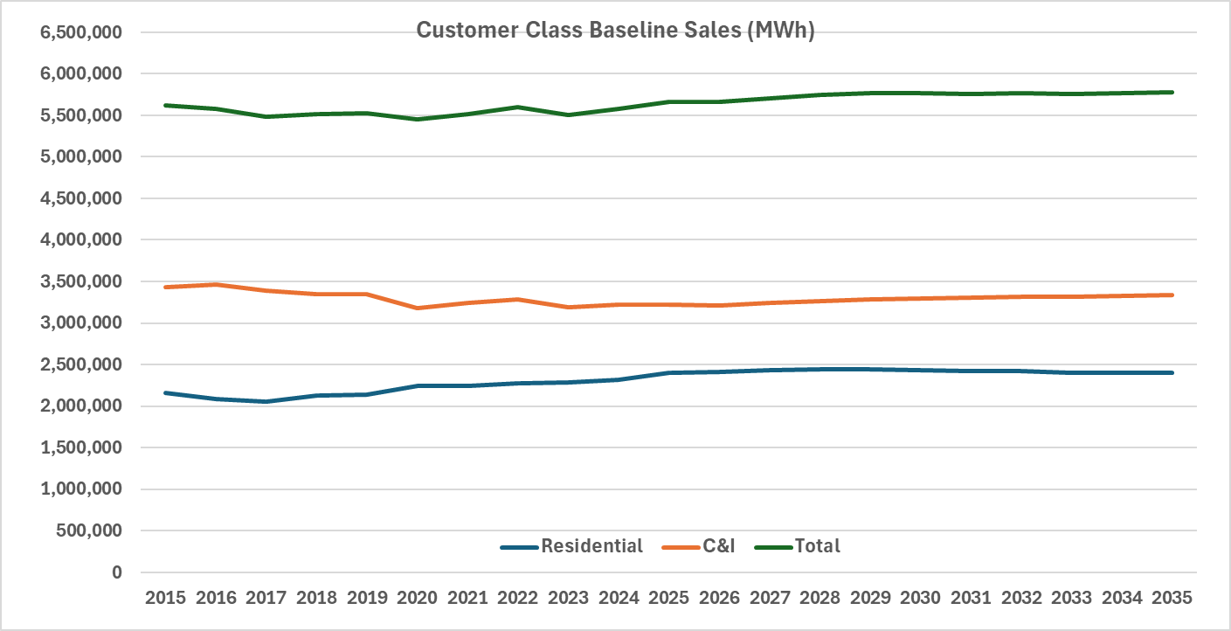
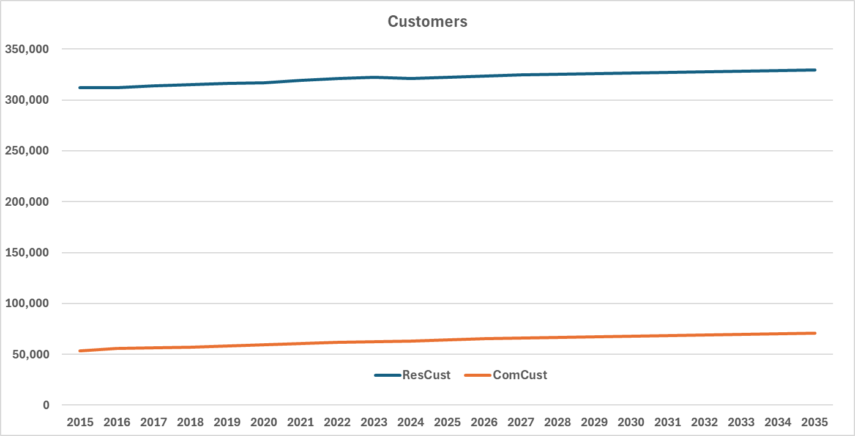
What’s Underneath
Residential
2015 – 2025, Positive sales growth since 2017
COVID bump in 2020, Strong heat pump sales
2025 – 2035, No baseline sales growth, 0.2% customer growth and 0.2% decline in average use
Efficiency gains (new standards kick in 2027) outweigh positive economic impact
Excludes impact of new solar, heat pump, and EV growth.
C&I
2015 - 2025
Large drop in 2020 sales. Slow, positive recovery, but still below 2019 consumption level
2025 - 2035
Strong increase in number of small customers
Lighting intensity decline mitigates some of the increase in computer related load growth. Much slower decline in ventilation intensity.
Moderate load growth tied to economic growth projections

Slide 13
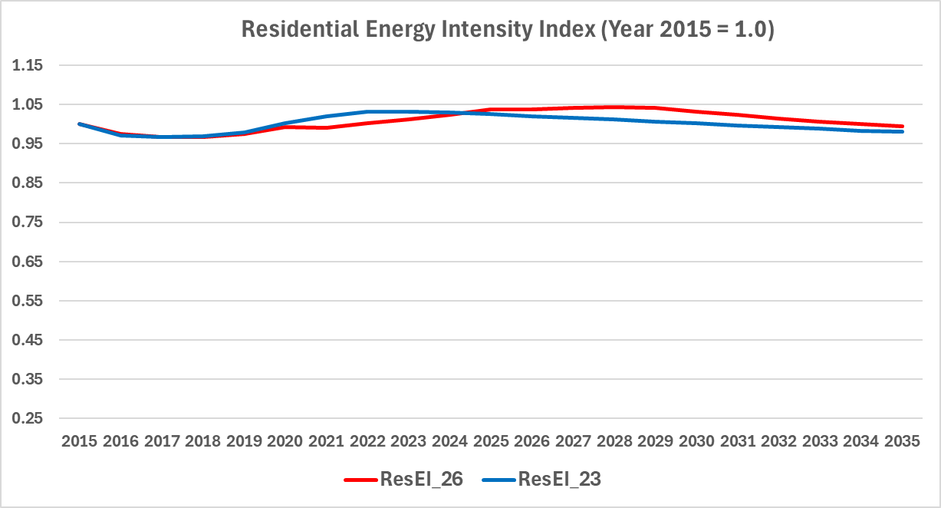
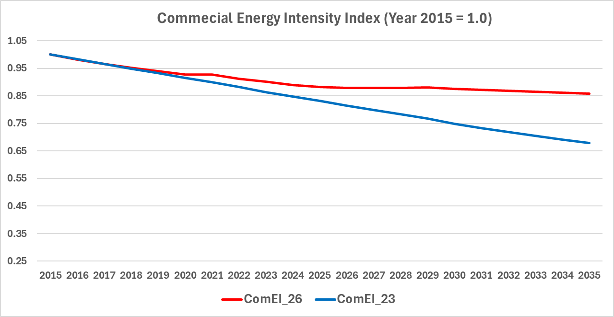
Energy Intensity Trends
Energy intensity trends reflect baseline saturation and efficiency trends
Indexed to 2015 to allow for comparison
2026 based on the AEO 2025 forecast
2023 based on the AEO 2022 forecast
Significant changes in AEO 2025
New residential end-use standards starting in 2027
Less extreme decline in commercial ventilation
Strong computer related load associated with data center and onsite computation

Slide 14
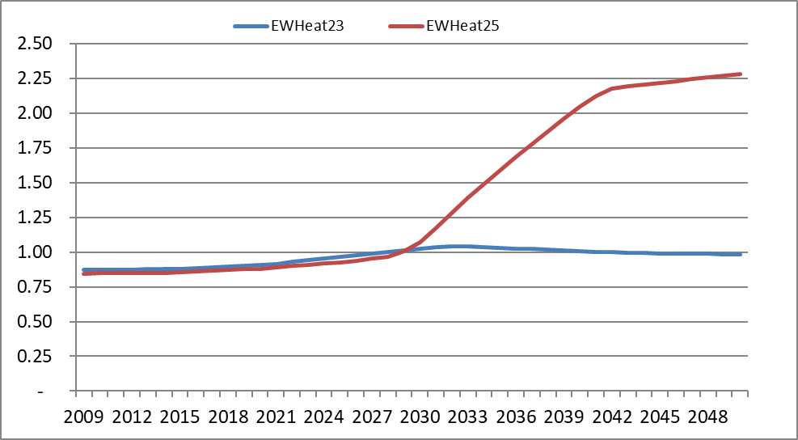
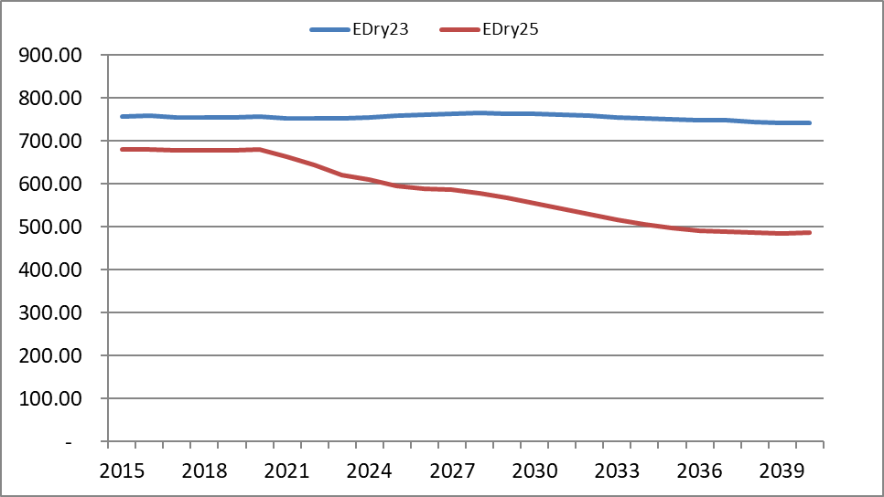
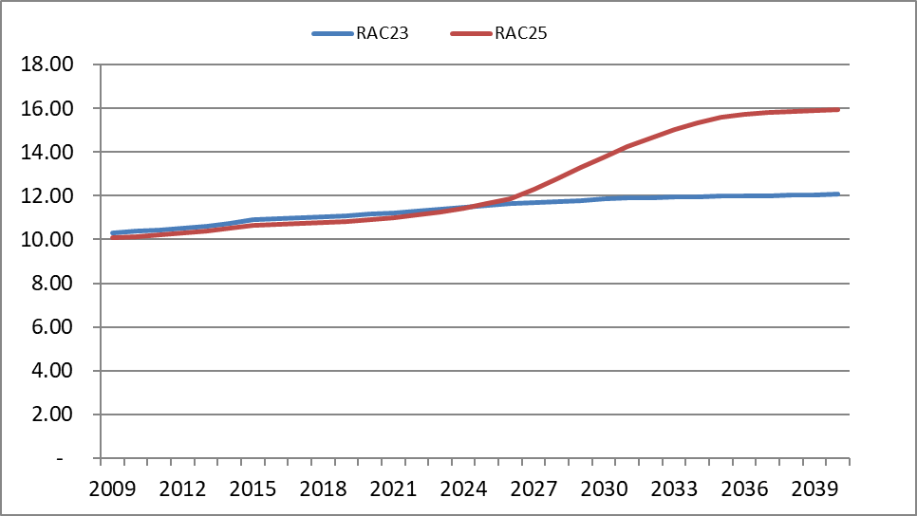
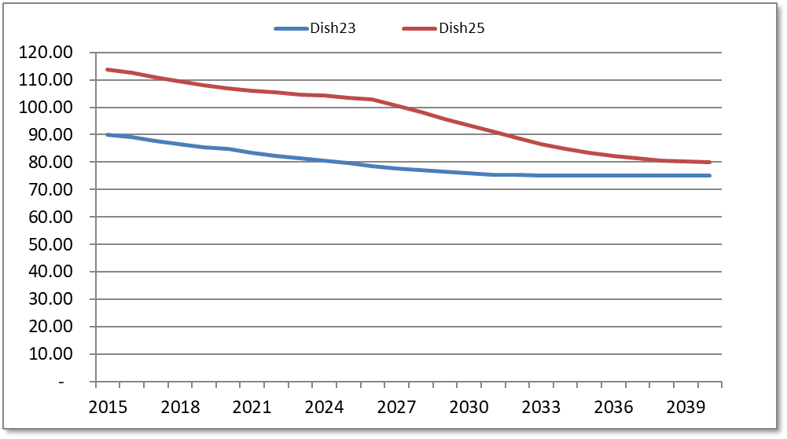
New Residential End-Use Standards – Impact on efficiency
Energy Factor
UEC
Dryer, 2028
Water Heater, 2029
Heat pump dryers
Heat pump water heaters
Energy Efficiency Rato
UEC
Room AC, 2027
Dish Washer, 2027
Variable speed motors
Limits water use per cycle

Slide 15
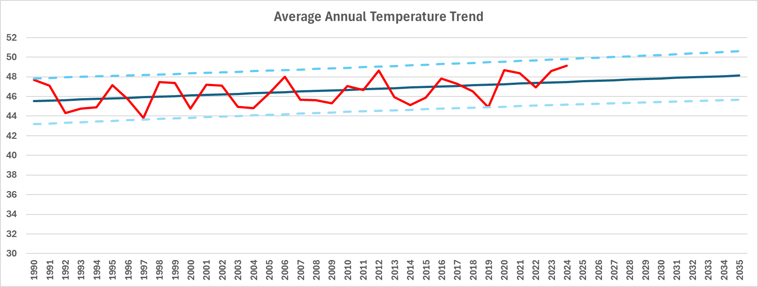

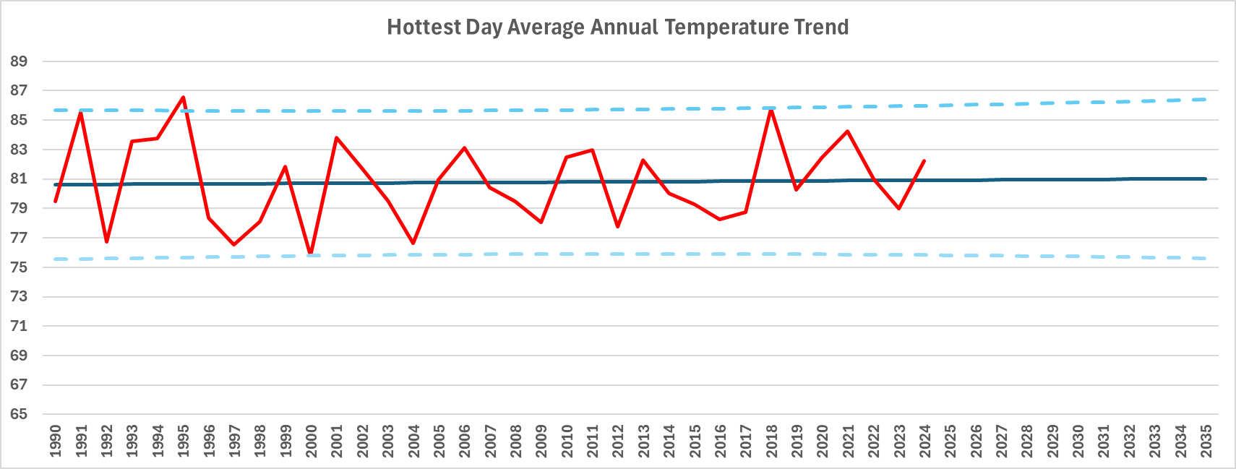

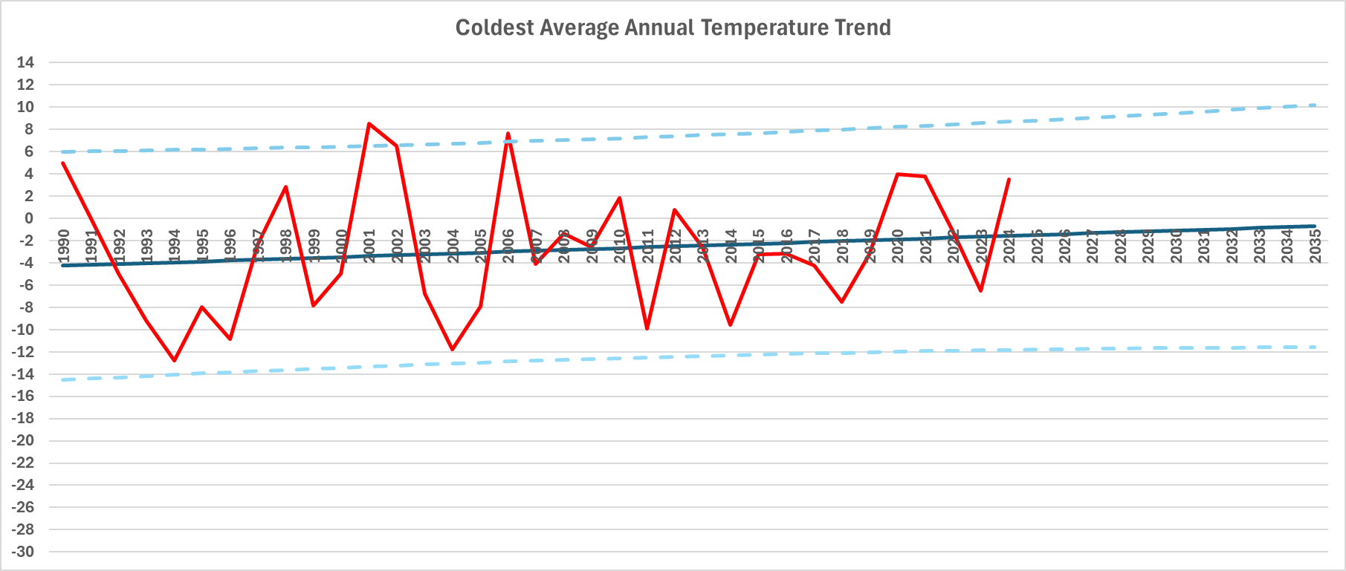

Temperature Trends – 1990 to 2024
Average Annual Temperature
Increasing .058 degrees per year (0.58 degrees per decade)
Hottest Day Average Annual Temperature
Statistically insignificant trend – days are not getting hotter
But there are more of them
Coldest Day Average Annual Temperature
Increasing 0.079 degrees per year (0.79 degrees per decade)

Slide 16
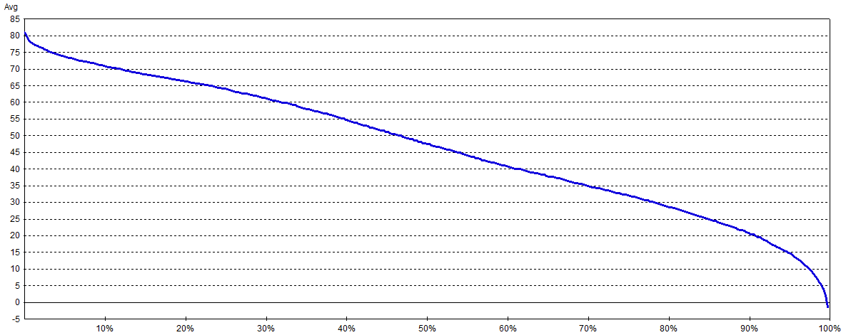
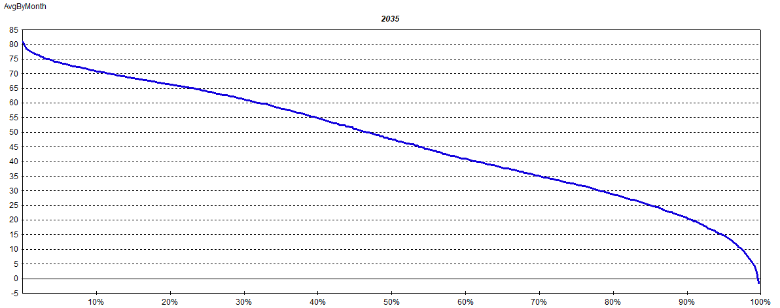
Translation to HDD and CDD
Held Constant
20-year average
Represents 2015 average temperature profile
Profile shifted out over time
Maximum is held constant
Minimum shifts out 0.079 degrees per year
Average shifts out 0.058 degrees per year
Results in a flatter temperature curve with fewer HDD and more CDD
Shifted 0.058 degrees per year
Shifted 0.079 degrees per year
2035: Flatter Temperature Curve

Slide 17
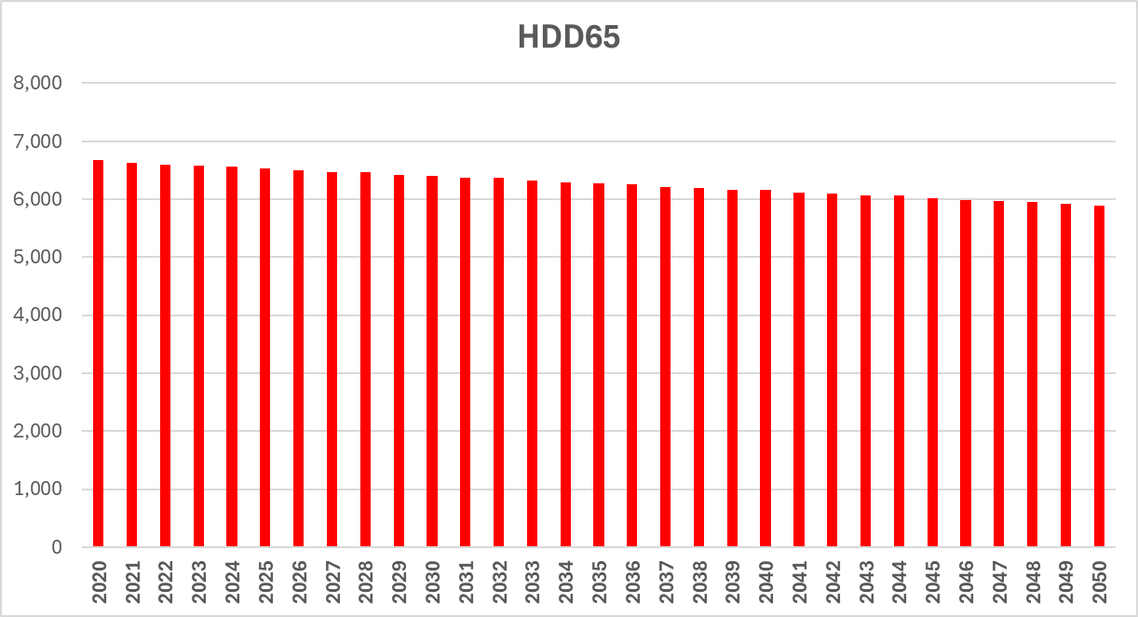
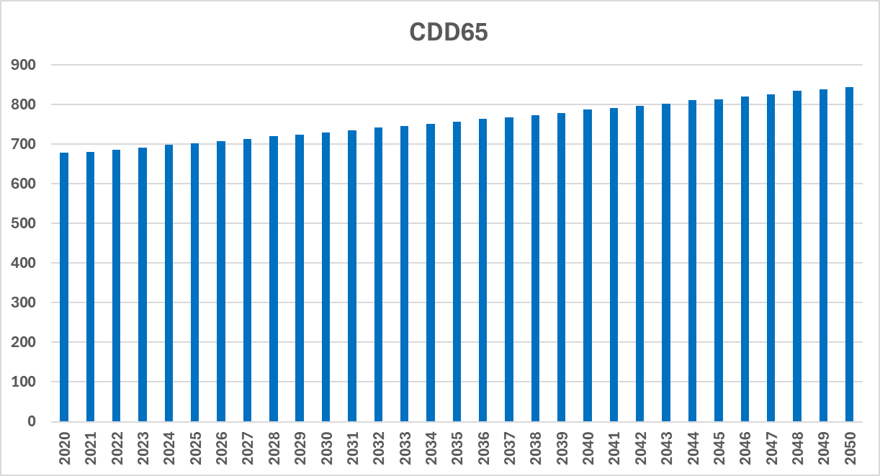
Trended Degree Days
Declines 0.39% per year
Increases 0.76% per year
Fastest decline in HDD and increase in CDD are in the shoulder months.

Slide 18
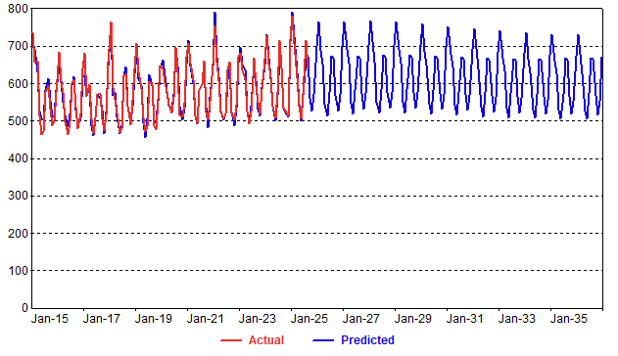
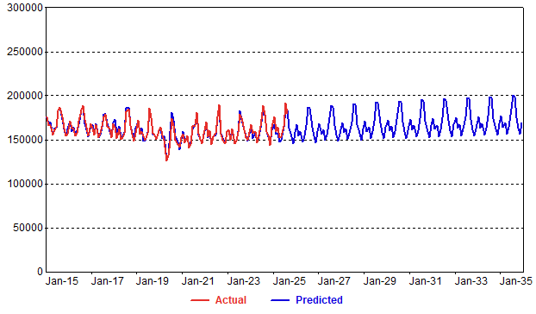


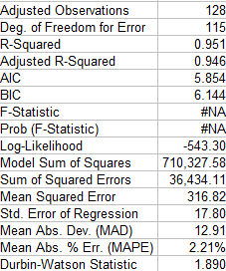
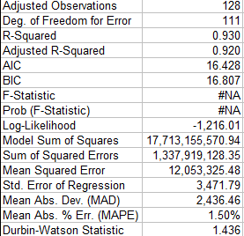
Income, End-Use Intensities, and Weather Combined to Drive Residential Average Use and Commercial Sales Forecast
Commercial Sales
Residential Average Use

Slide 19
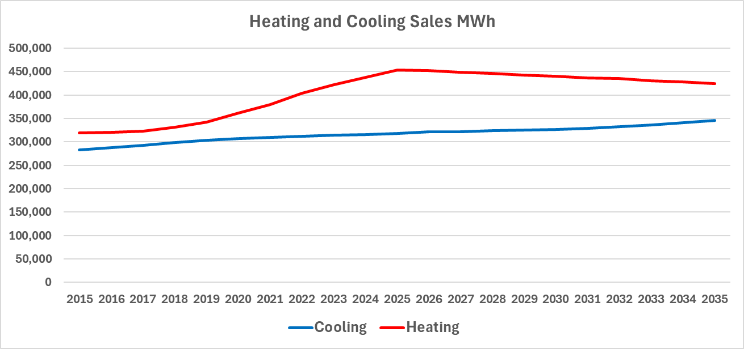
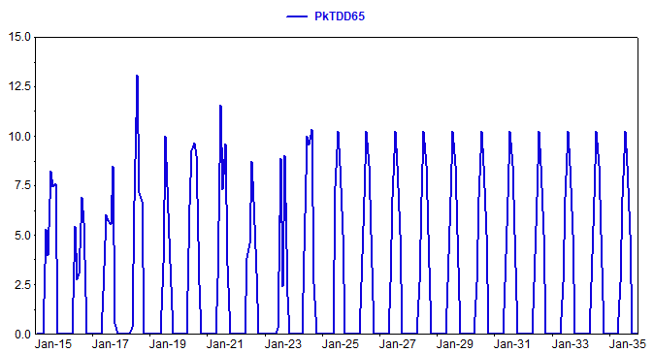
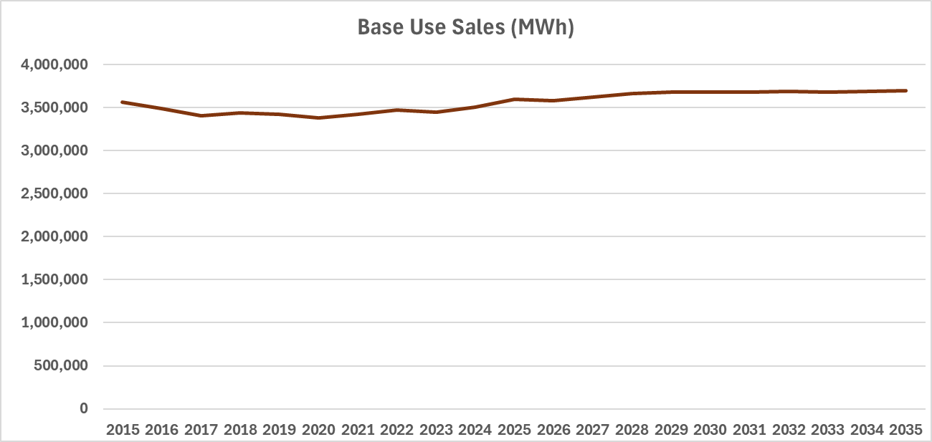
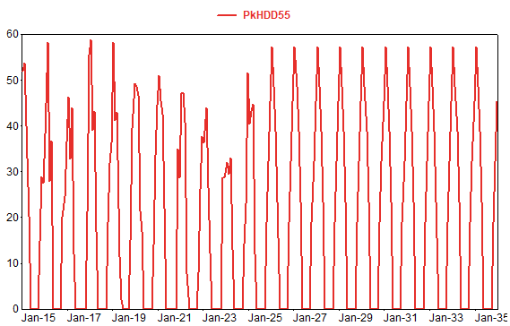
Baseline Gross Peak Forecast
Driven by end-use energy derived from baseline sales models
Combined with Peak-Day Weather

Slide 20
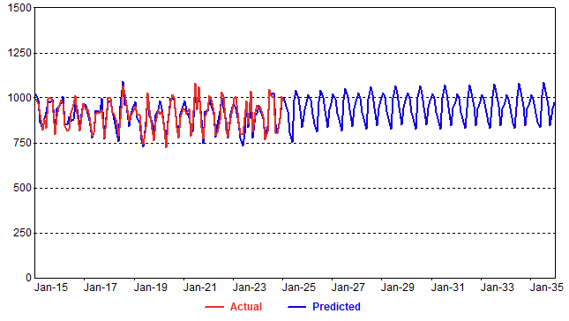
Baseline Gross Peak Demand

Slide 21
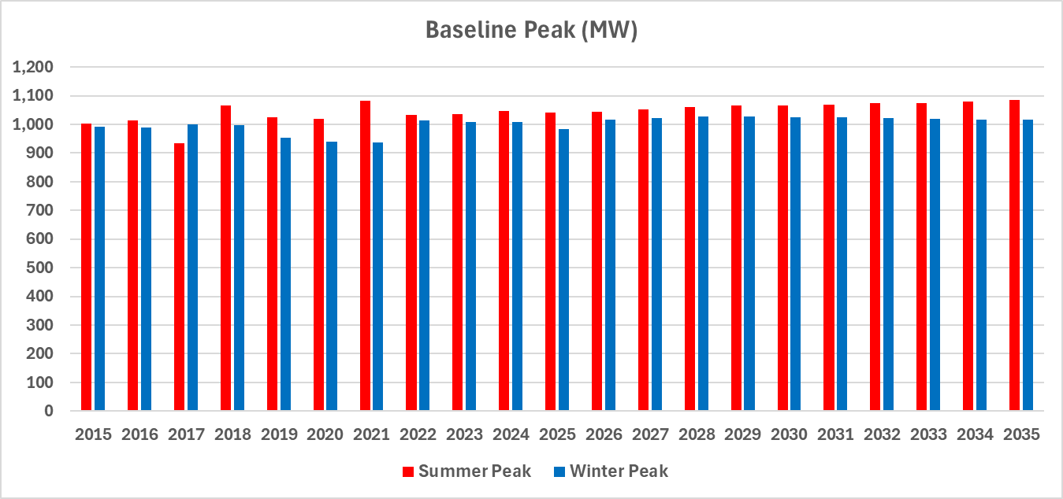
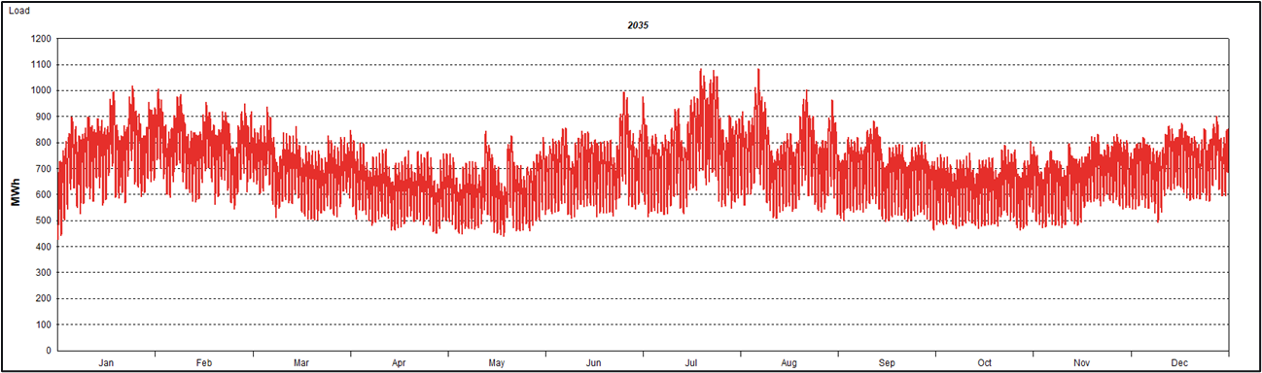
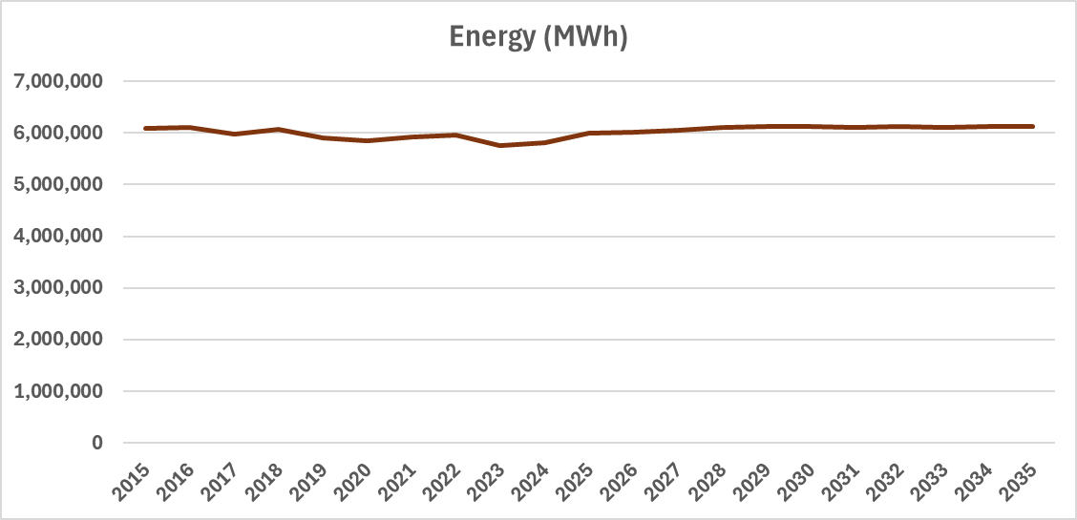
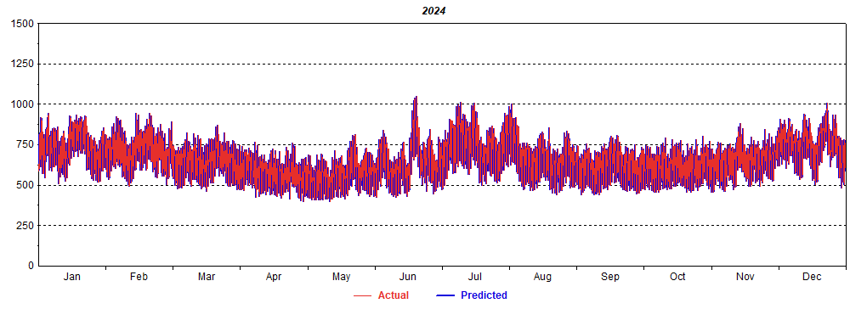
Baseline Gross Hourly Load Forecast
Calculated by Combining Baseline Energy, Peak, and Baseline Hourly Load Profile

Slide 22
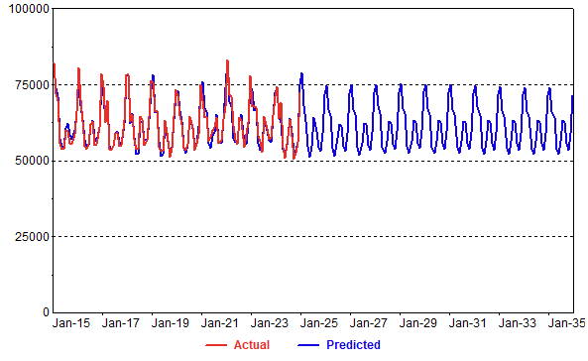
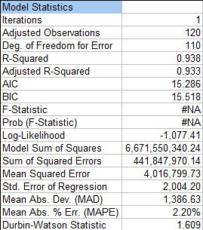

Baseline Zone Energy Models
Driven by county economic forecast, but tied to the system forecast
Zone residential sales = system res average use * zone household forecast
Zone C&I sales = use per employee * zone employee forecast
Zone residential and C&I sales used in calibrating system heating, cooling, and base-use energy forecast to the zone
Separate weighted heating and cooling variables for each zone based on weather weights estimated with ANN models (An AI application)
Zone energy forecast capture differences regional household and economic growth, changing mix of residential
and commercial custom over time, and differences (if any) in weather response
Southern

Slide 23
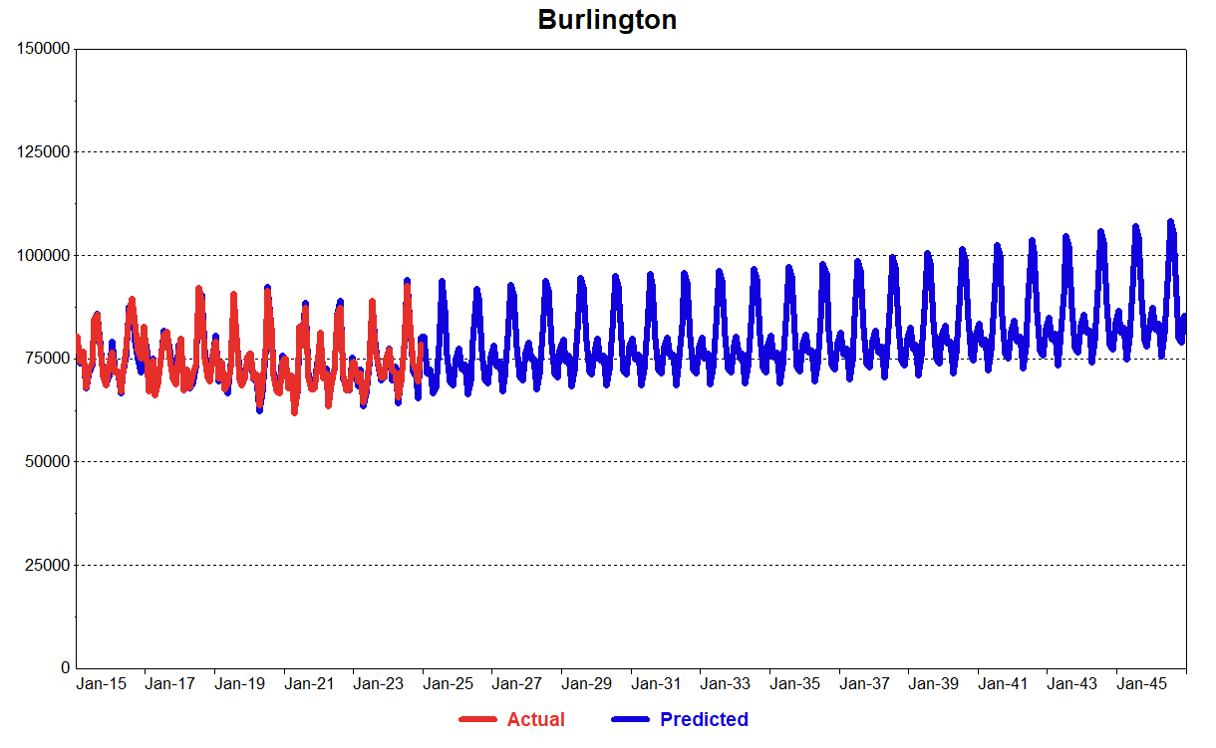
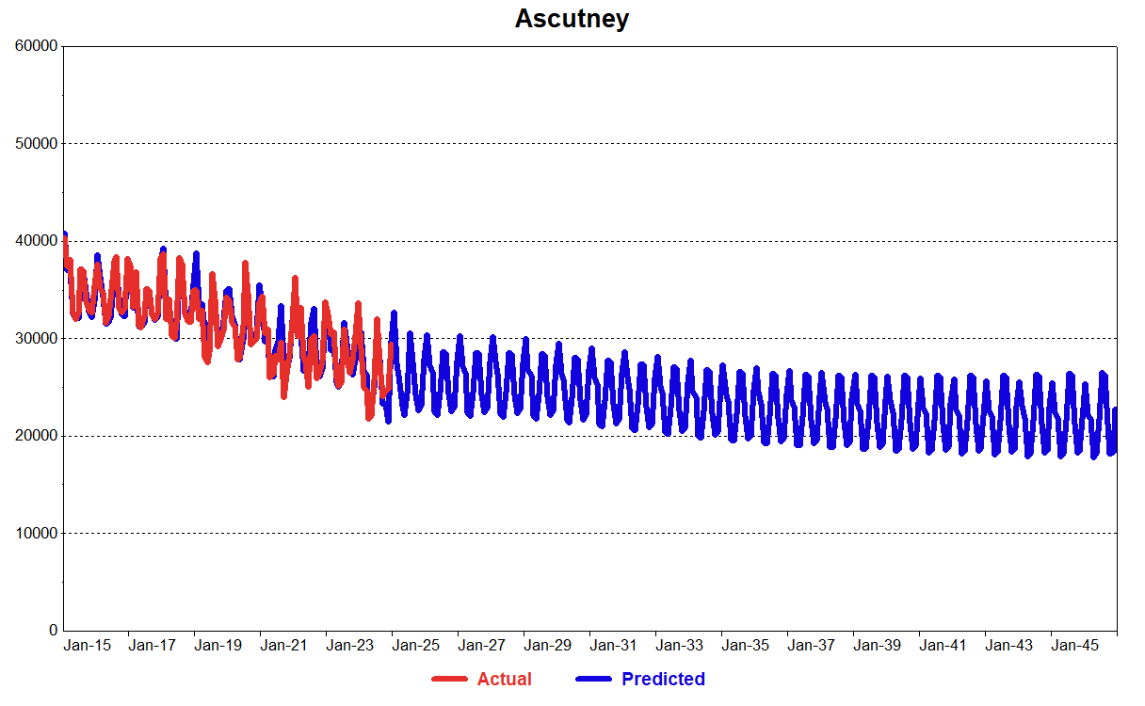
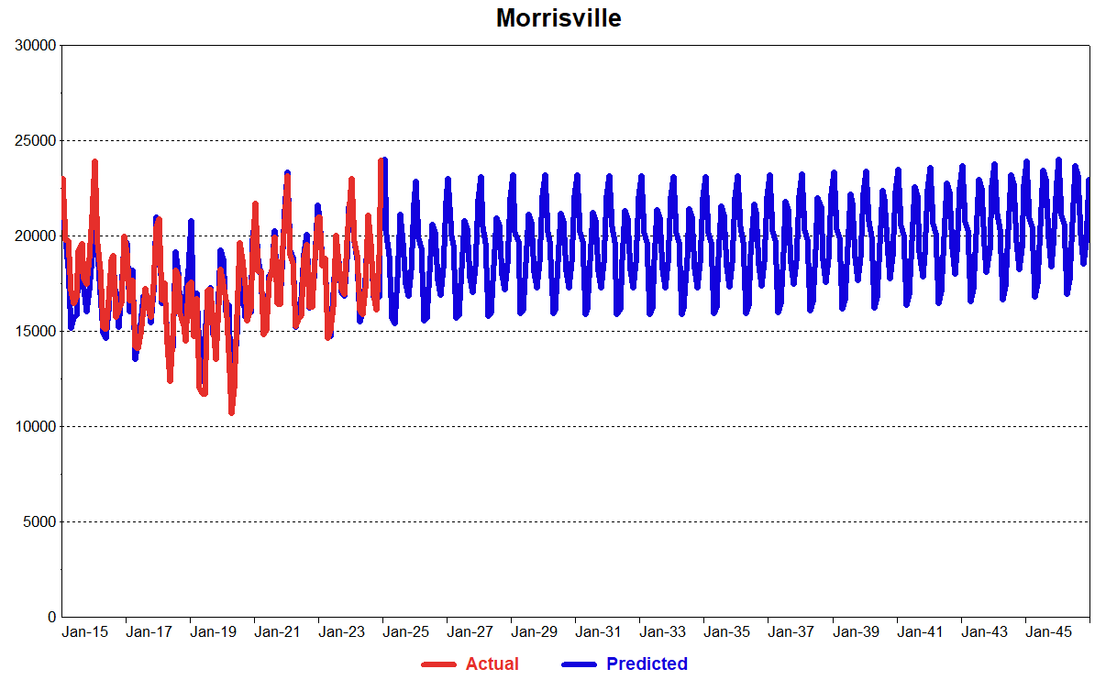
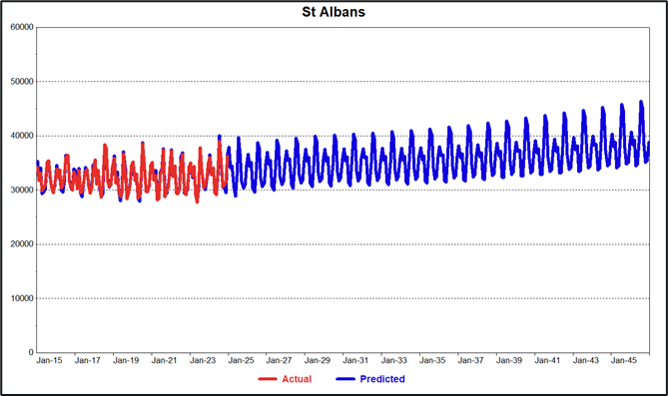
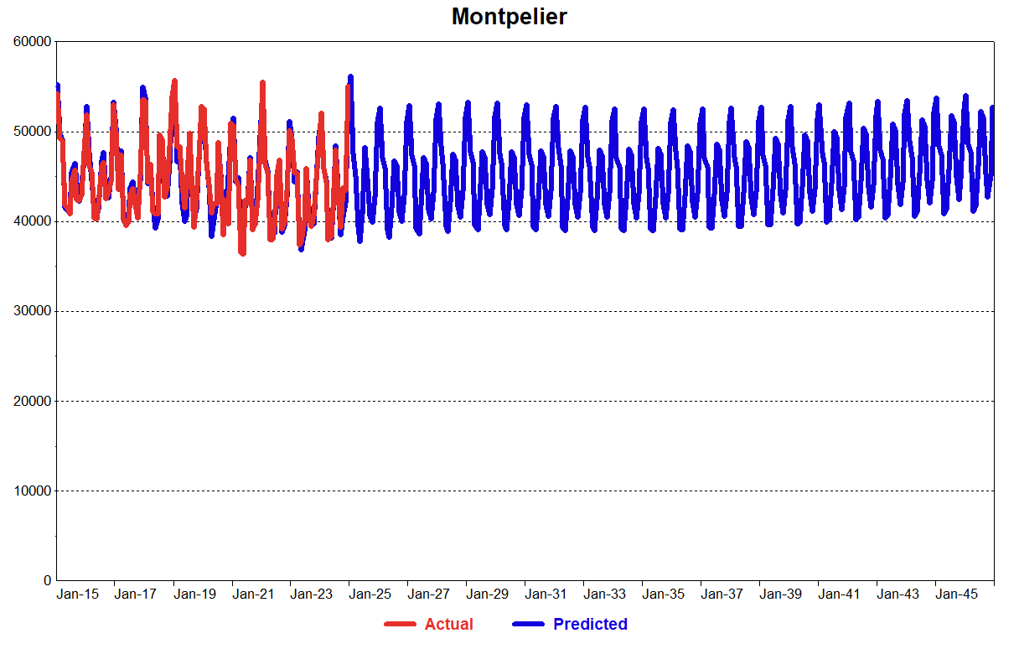
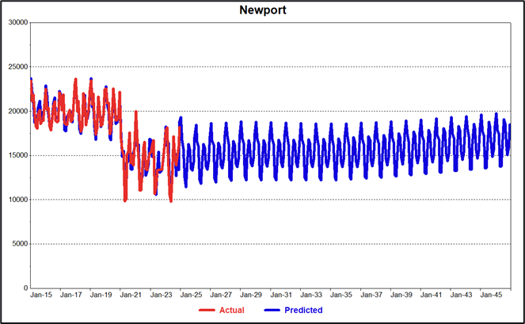
Zonal Baseline Energy Forecast

Slide 24
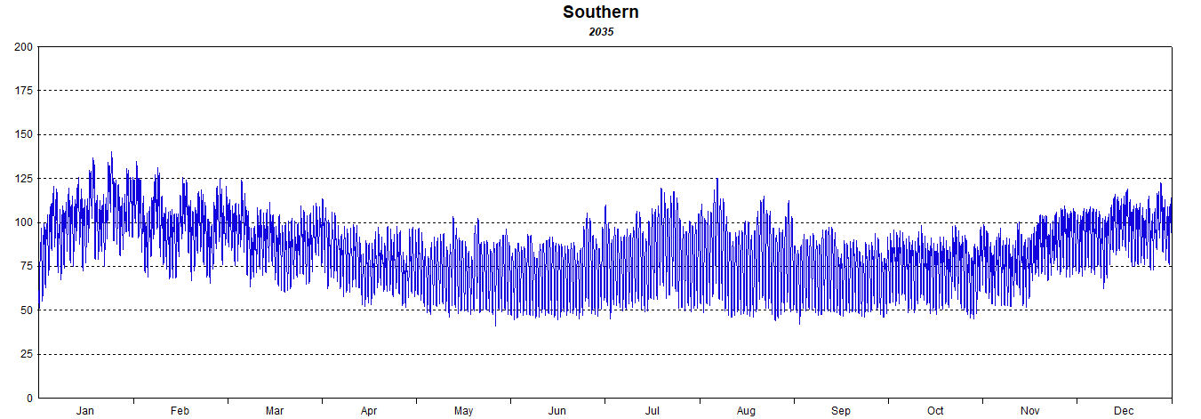
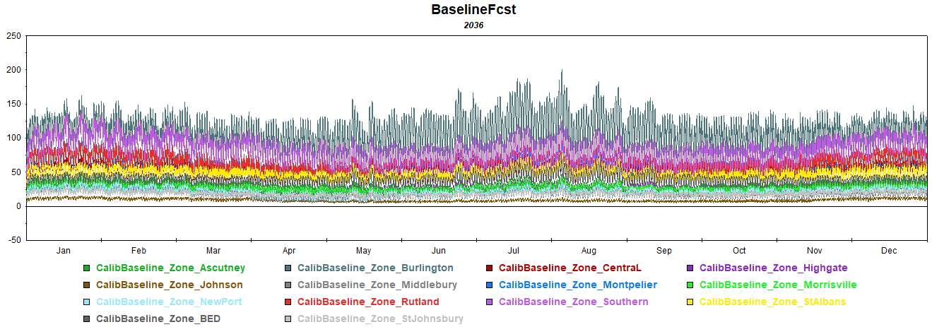
Zone Baseline Hourly Load Forecast
Zone energy forecasts combined with zone hourly load profile
and calibrated to baseline system hourly load

Slide 25
Heat Pumps

Slide 26
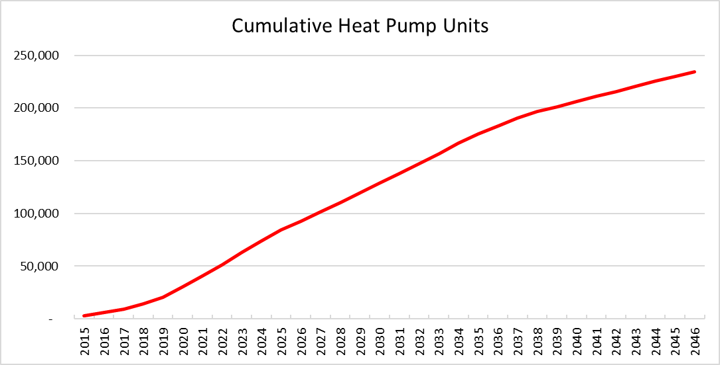
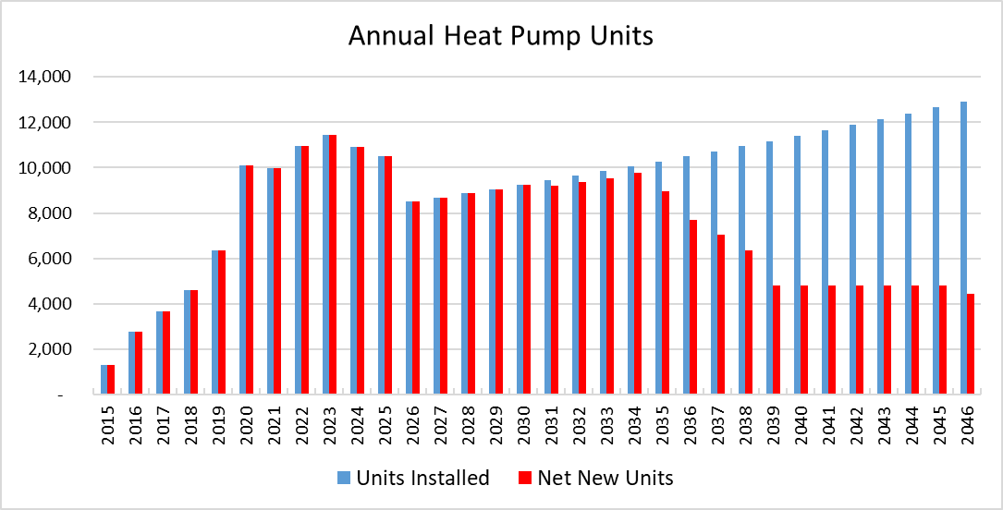
Heat Pump Forecast: Units and Saturations
Assume 8,500 units per year starting in 2026, growing at the same rate as residential customers
Assumes a 15-year life cycle, in the outer years most units are replacing existing units and not adding to net new heat pumps.
By 2046 50% of Vermont residential customers have a heat pump

Slide 27
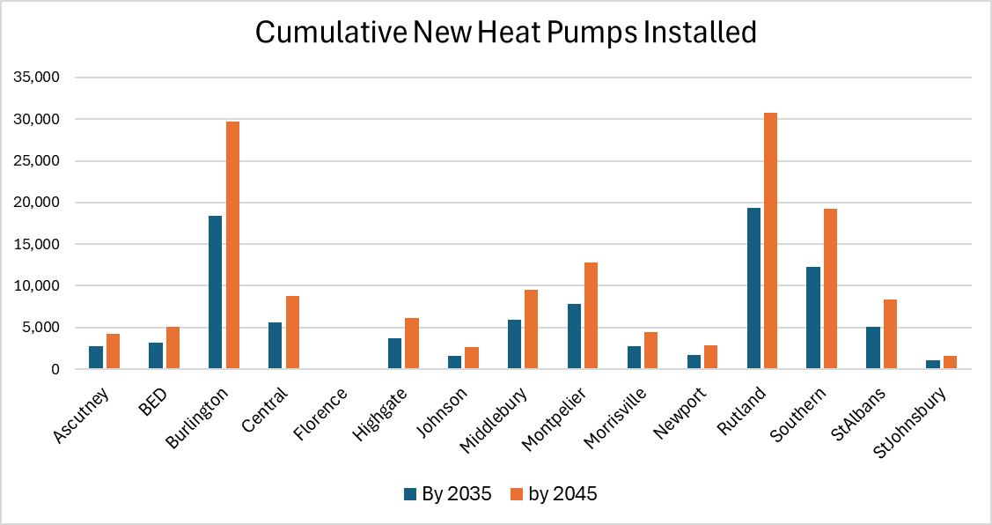
Heat Pump Forecast by Zone
State total heat pumps are allocated to zones based on relative income growth rates by county.

Slide 28
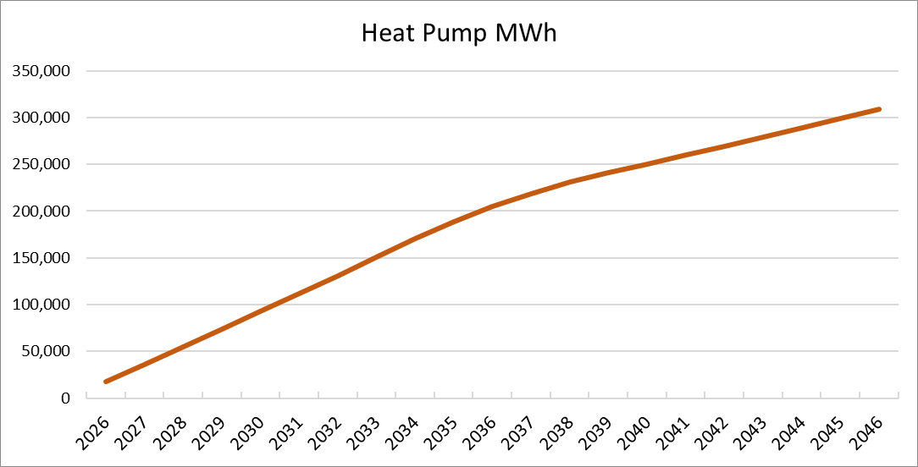
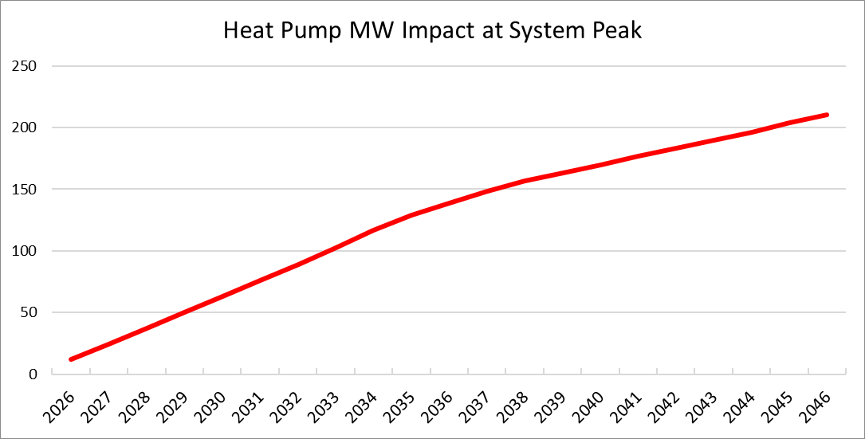
Heat Pump Forecast: MWh and Impact on Demand
The forecast is adjusted for cumulative incremental new heat pumps, the impact of existing heat pump is embedded in the historical load data
We assume 2,087 kWh per heat pump for all zones except Addison, Chittenden, and Frankline.
Based on the 2024 Vermont heat pump study the average UEC for customers in areas with access to natural gas is 989 kWh. For these zones we use a weighted average ranging from 1,353 kWh to 1,981 kWh.
Demand impact is based on hourly heating profile and coincident with system and zonal peaks.

Slide 29
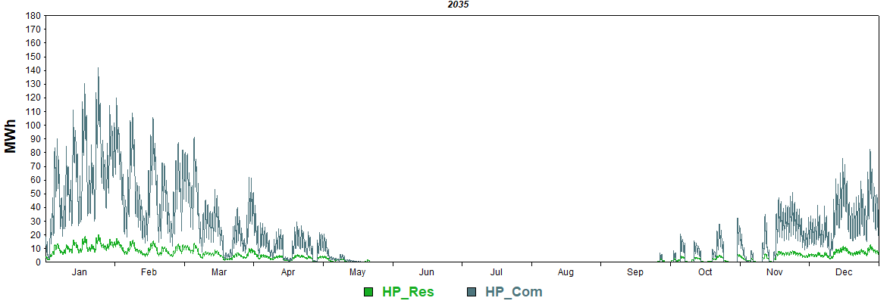
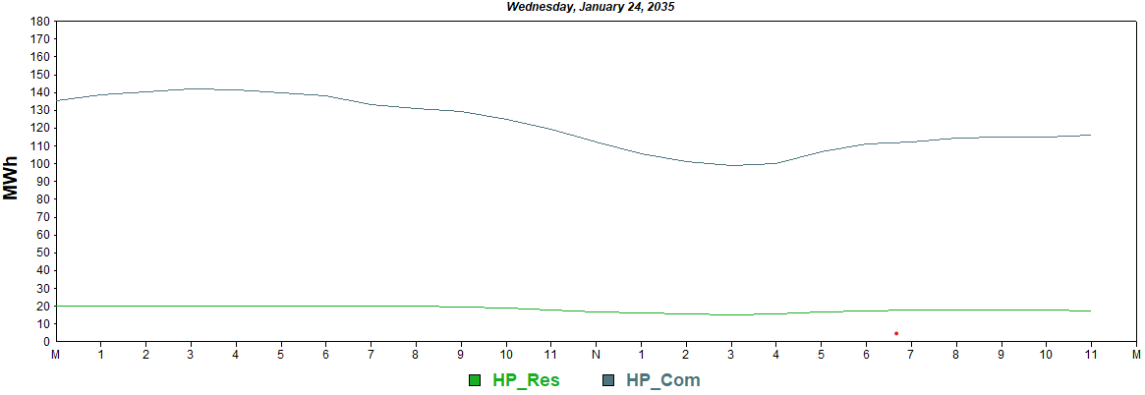
Hourly HP Profile
The profiles are derived from total hourly residential and commercial AMI for GMP.
Heating loads are estimated based zeroing out the impact of heating degrees from the total class loads

Slide 30
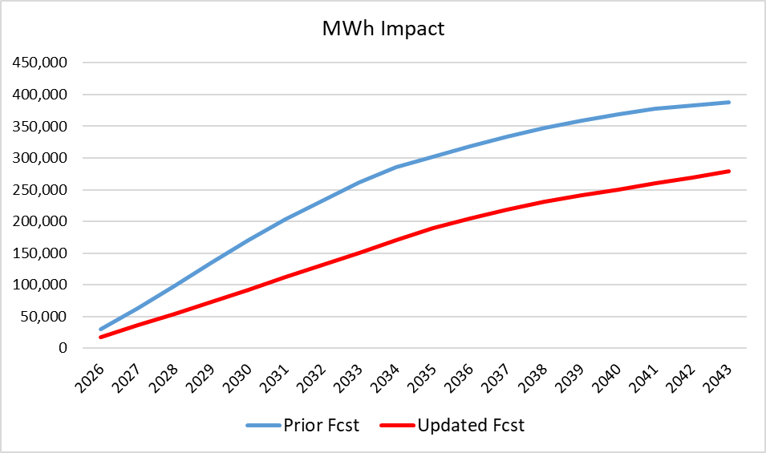

Comparison to prior HP forecast
Fewer units and lower kWh per unit drive down MWh impact
MW impact driven by lower MWh and timing of total system peak. Total system peak timing is driven by heat pumps, electric vehicles, and solar.

Slide 31
Solar Load

Slide 32

Solar Capacity Forecasting Approach
Capacity is modeled as a function of simple payback.
Payback incorporates:
system costs, incentives (expiring tax credits), electric rates, and payments for excess generation.
Cubic model specification used to impose S-shaped adoption curve.
Expiration of federal tax credits increases the payback from 6 to 8 years. Adoption is 2026 and 2027 is assumed to be 50% lower. Beginning in 2028, adopting begins to increase.

Slide 33

Solar Capacity Forecast
A unique small and large solar capacity forecast is generated. Specific load factors and shape are used to determine solar generation and hourly impacts.
Small systems are defined as systems less than 1000 kW
Through 2035 this forecast is approximately 20 MW lower than the prior solar forecast.

Slide 34

Zonal Capacity Forecast

Slide 35


Large and Small Solar Generation Profiles
Small Solar Profile
Large Solar Profile

Slide 36


Impact on Peak
The incremental impact on peaks is small in the summer months and zero in the winter months due to the timing of the system peak.

Slide 37
Electric Vehicles

Slide 38
Current Electric Vehicle Market Information: Vermont
As of January 2026, there were approximately 20,967 registered electric vehicles in the state, comprised of all electric (BEV) and plug-in hybrid electric (PHEV).
62% BEV and 38% PHEV
3,028 additional EV were added over the past year, a 17% increase, this is down from previous years.
7.8% of light duty vehicle sales in the 4th quarter of 2025, 9.9% of light duty vehicle sales in the 3rd quarter of 2025, 12.4% of light-duty sales in the 4th quarter, 2024.
Top 5 most popular models sold in the 4th quarter of 2025 were the Hyundai Ioniq 5, Tesla Model Y, Toyota RAV4 Prime, Volkswagen ID.4, Chevrolet Equinox EV.
Federal tax credits expired on Sept 30th, 2025.
US: 4th quarter 2025 EV sales dropped to 234,000 units, a 46% decline from Q3 and 36% lower year-over-year. Some of this drop is due to seasonal patterns and not solely a drop in demand.
Source: Drive Electric Vermont and Cox Automotive

Slide 39

Quarterly Change in EV Registrations
Q3 2025 uptick likely driven by rush to take advantage of expiring federal tax credits. Q4 is lowest quarter since Q2 2022.
Source: Drive Electric Vermont

Slide 40
Electric Vehicle Forecast Model
Develop a state-level EV forecast using a stock accounting model based on EV sales targets.
Starting with the most recent EV sales and EV registrations
EV sales targets based on state mandates; 35% by 2026, 68% by 2030, 100% by 2035
Assumptions regarding BEV/PHEV splits, annual miles, kWh per mile, average vehicle life
Forecast county EV registrations as a function of county household income.
Calibrate county EV forecast to state EV forecast
Validate reasonableness of county allocation
Combine EV MWh forecast with hourly charging profiles
Home charging versus public charging
Uncontrolled home charging versus controlled or TOU rates

Slide 41

County EV Forecast (100% new car purchases are electric by 2035)
Addison, Chittenden, and Washington county have rates of 2 EVs per household, which is slightly higher than the state average of 1.7 total vehicle per household. Reasonable given these are more populated and higher income counties.

Slide 42
Hourly EV Charging Assumption
Forecast assumes that 80% of charging occurs at home and 20% away from home at public or workplace chargers. Home charging is allocated to one of three charging strategies.
No incentivized rate: We assume 25% of EV owners are not signed up for any rate, this declines to 10% by 2046.
Incentivized TOU Rate: 2/3 of customers on an incentivized rate are on the TOU rate. We have created 3 staggered start TOU rates, with the incentive rate beginning at 9pm, 10pm, and 11pm. The customers are evenly distributed across the three start times.
Incentivized Managed/Controllable Rate: 1/3 customers on an incentivized rate are on managed/control rate. Their hourly charging pattern is the same as the non incentivized rate customers; the impact of control is not embedded in the forecast.
We can quantify the demand impact of control events and provide these estimates for sensitivity analysis or forecast scenarios

Slide 43

Hourly EV Profiles
All zones use the same non incentive/incentive allocation factors. Except for BED, which we know has its own EV incentive rate

Slide 44

Hourly EV Profiles
All zones use the same non incentive/incentive allocation factors. Except for BED, which we know has its own EV incentive rate

Slide 45

Fleet/Commercial EV Forecast
Based on ISO New England’s 2025 Transportation Electrification Forecast for Vermont, May 2025
State-level forecast of light-duty fleet, medium-duty fleet, school bus, and transit bus

Slide 46

EV Demand Impact

Slide 47

EV Demand Impact

Slide 48


Comparison to prior EV forecast
Slower initial adoption of EVs but ultimately reaching similar numbers in the outer years.
Significant change in hourly charging assumptions

Slide 49
Forecast Comparison

Slide 50
System Peak Forecast

Slide 51


Hourly System Profile
The baseline forecast is reconstituted for historical solar
The adjusted forecast subtracts all solar generation and adds the incremental impact of EV and heat pumps.
The adjusted forecast becomes winter peaking driven by heat pump and EV charging profiles

Slide 52


Comparison Against Prior Forecast
Updated winter peak is 192 MW lower in 2035 and 109 MW lower in 2040.
Updated summer peak is 119 MW lower in 2035 and 45 MW lower in 2040

Slide 53

Comparison to Prior Long-term Load Forecast: Year 2035

Slide 54
Possible Forecast Scenarios
Weather based scenarios
Extreme weather, multiple hot/cold days, increased/decreased temperature trends
Slower adoption of EV
Impact of EV control rate
Battery Storage
Stronger/Weaker economic growth

Slide 55


http://www.itron.com/forecasting

